Slide 1


CHINA
中国
Press right/down arrow or enter to continue.
Click the home button to go to the menu.
China January 2021 Update
Copyright © Group B 2018-2021
按右/下箭头或输入以继续。
单击主页按钮转到菜单。
中国 2021年1月更新
版权© B 集团 2018-2021
Studios
ENGLISH AND SIMPLIFIED CHINESE
英语和简体中文
Presents:

Slide 2

SLIDE BOARD
滑动板
BASICS/基本
CHINA POPULATION/中国人口
GENERALLY/通常
GREAT WALL/长城
THE CHINESE CUISINE/中国菜
SOME… CHINESE MEALS/一些…中国餐
HISTORY/历史
CORONAVIRUS/新冠病毒
SOME PICTURES/一些图片
X
About…/关于...

Slide 3

BASICS
基本
Capital: Beijing
Area: 9,596,961 km²
Population: 1.439.323.776
首都：北京
面积：9,596,961平方千米
人口：1.439.323.776

Slide 4
CHINA POPULATION
中国人口

Slide 5
CHINA POPULATION
中国人口

Slide 6
CHINA POPULATION
中国人口

Slide 7
CHINA POPULATION
中国人口

Slide 8
CHINA POPULATION
中国人口

Slide 9
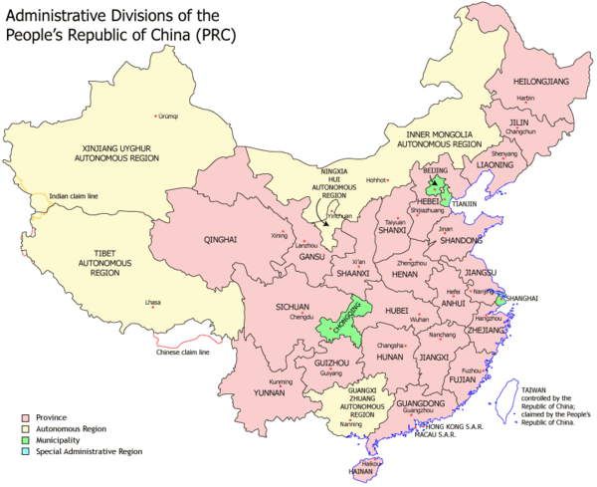
GENERALLY
通常
China officially the People's Republic of China (PRC) is a country in East Asia. It is the world's most populous country. Governed by the Communist Party of China, the state exercises jurisdiction over 22 provinces, five autonomous regions, four direct-controlled municipalities (Beijing, Tianjin, Shanghai, and Chongqing), and the special administrative regions of Hong Kong and Macau.
中国中华人民共和国是东亚的一个正式国家。 它是世界上人口最多的国家。 国家由中国共产党领导，对22个省，五个自治区，四个直辖市（北京，天津，上海和重庆）以及香港和澳门特别行政区行使管辖权。

Slide 10
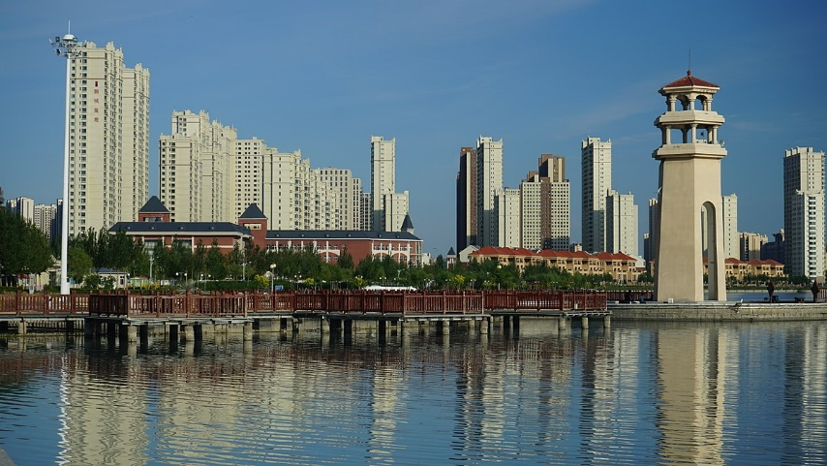
GENERALLY
通常
Aside from the "municipalities" and the "SAR's", there are 23 provinces and five "autonomous regions", or regions with more law-making rights than the provinces and with many people of a minority group population. They are theXinjiang Uyghur Autonomous Region, the Tibet Autonomous Region or Xizang Autonomous Region, the Guangxi Zhuang Autonomous Region, the Inner Mongolia Autonomous Region or Nei Mongol Autonomous Region, and theNingxia Hui Autonomous Region.
除了“市辖区”和“特区”外，还有23个省和5个“自治区”，或者说，这些自治区的立法权高于各省，并且有许多少数民族人口。它们是新疆维吾尔自治区，西藏自治区或西藏自治区，广西壮族自治区，内蒙古自治区或内蒙古自治区以及宁夏回族自治区。

Slide 11
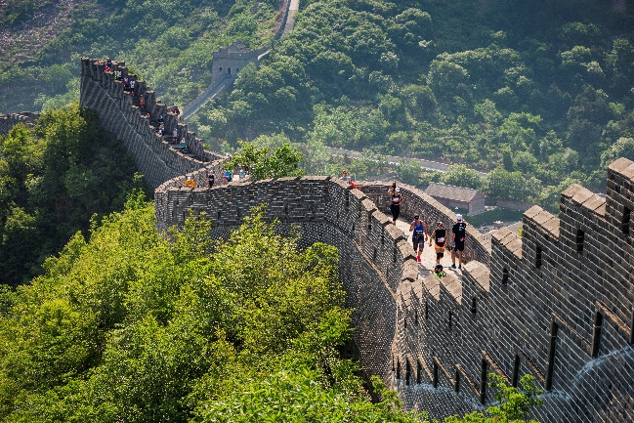
GREAT WALL
长城
The Great Wall of China is the collective name of a series of fortification
systems generally built across the historical northern borders of China to protect and consolidate territories of Chinese states and
empires against various nomadic groups of the steppe and their polities.
中国长城（中文：万里长城；拼音：WànlChángchéng）是一系列设防系统的总称，这些设防系统通常跨过中国历史悠久的北部边界，用以保护和巩固中国各邦和帝国的领土，抵御各种游牧民族草原及其政体。

Slide 12
THE CHINESE CUISINE
中国菜
Chinese regional cuisines are the different cuisines found in different provinces and prefectures of China as well as from larger Chinese communities overseas.
中国地区美食是在中国不同省份以及海外较大的华人社区中发现的不同美食。

Slide 13
THE CHINESE CUISINE
中国菜
A number of different styles contribute to Chinese cuisine but perhaps the best known and most influential are Cantonese cuisine, Shandong cuisine, Jiangsu cuisine ( specifically Huaig cuisine) and Szechuan cuisine.
中国菜有许多不同的风格，但最有名和最有影响力的是粤菜，山东菜，江苏菜（特别是淮扬菜）和四川菜。

Slide 14
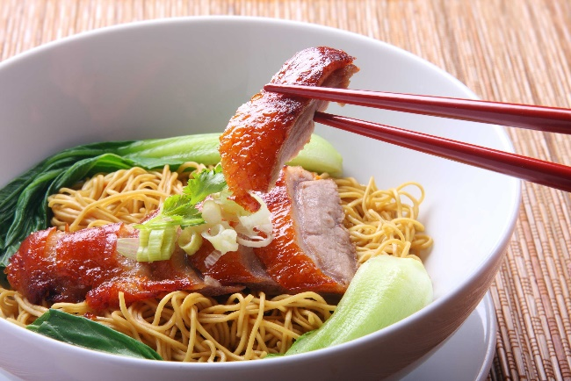
THE CHINESE CUISINE
中国菜
These styles are distinctive from one another due to factors such as availability of resources, climate, geography, history, cooking techniques and lifestyle .One style may favour the use of lots of garlic and shallots over lots of chilli and spices, while another may favour preparing seafood over other meats and fowl.
由于资源的可获得性，气候，地理，历史，烹饪技术和生活方式等因素，这些样式彼此不同。一种风格可能比大量辣椒和香料更喜欢使用大量的大蒜和葱，而另一种风格则可能更喜欢使用海鲜而不是其他肉类和禽类。

Slide 15

SOME… CHINESE MEALS
一些…中国餐
SWEET AND SOUR SAUCE
糖醋汁

Slide 16
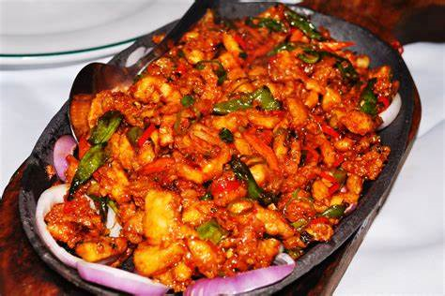
SOME… CHINESE MEALS
一些…中国餐
RASHANA BILASH
拉珊娜·比拉什

Slide 17
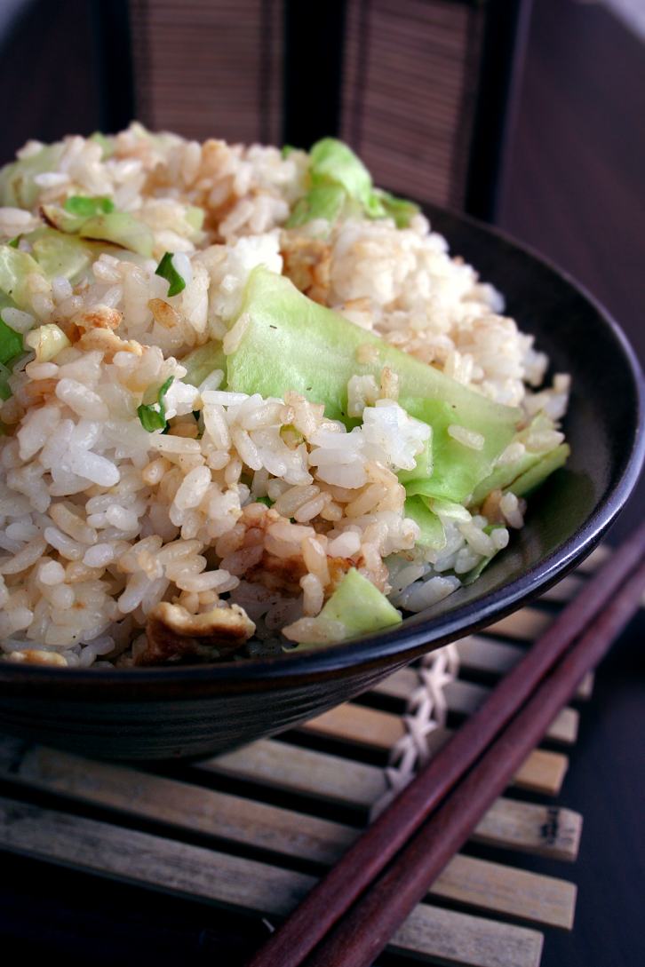
SOME… CHINESE MEALS
一些…中国餐
CHINESE FRIED RICE
中式炒饭

Slide 18
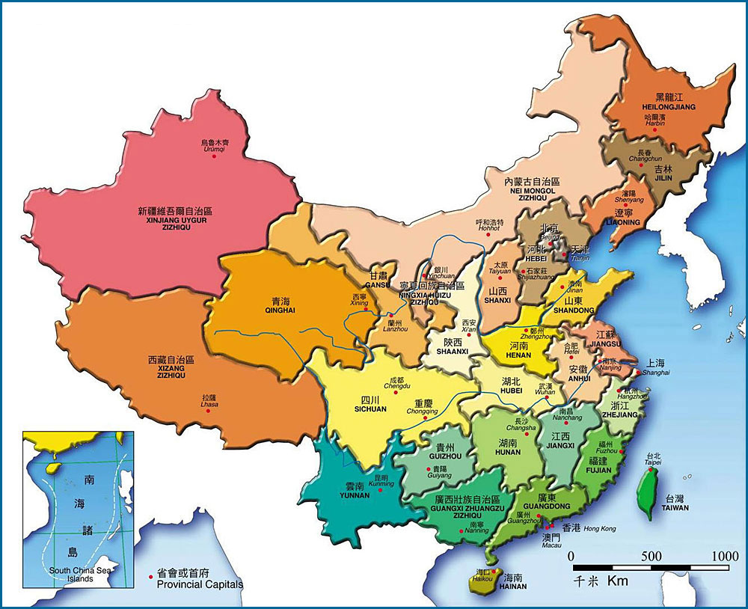
SOME PICTURES
一些图片
CHINA MAP
中国地图

Slide 19
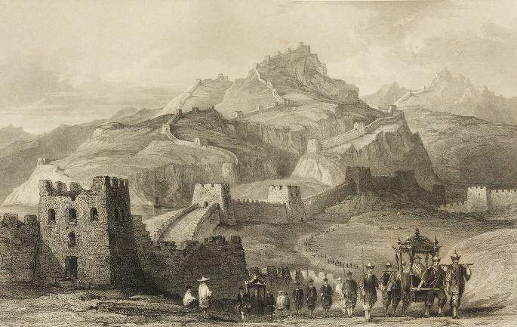
HISTORY
历史
According to Chinese tradition, the first dynasty was the Xia, which emerged around 2100 BCE. Xia dynasty marked the beginning of China's political system based on hereditary monarchies, or dynasties, which lasted for a millennia.The dynasty was considered mythical by historians until scientific excavations found early Bronze Age sites at Erlitou, Henan in 1959. It remains unclear whether these sites are the remains of the Xia dynasty or of another culture from the same period.The succeeding Shang dynasty is the earliest to be confirmed by contemporary records. The Shang ruled the plain of the Yellow River in eastern China from the 17th to the 11th century BCE.
根据中国的传统，第一个王朝是夏朝，它大约在公元前2100年出现。 夏朝标志着中国的政治制度的开始，这个政治制度以世袭君主制为基础，持续了几千年。历史学家一直认为该朝代是神话，直到1959年科学发掘在河南省二里头发现了青铜时代的早期遗址。目前尚不清楚 这些遗址是夏朝或同一时期的另一种文化的遗迹。后继的商朝是最早由当代记载所证实的地方。 从公元前17世纪到11世纪，尚氏统治着中国东部的黄河平原。

Slide 20
HISTORY
历史
The Shang was conquered by the Zhou, who ruled between the 11th and 5th centuries BCE, though centralized authority was slowly eroded by feudal warlords. Some principalities eventually emerged from the weakened Zhou, no longer fully obeyed the Zhou king and continually waged war with each other in the 300-year Spring and Autumn period. By the time of the Warring States period of the 5th–3rd centuries BCE, there were only seven powerful states left.
商朝被公元前11至5世纪统治的周所征服，尽管中央集权逐渐被封建军阀侵蚀。 某些公国最终从疲弱的周中崛起，不再完全服从周王，在300年春秋战国时期不断发动战争。 到公元前5至3世纪的战国时期，只剩下七个强大的国家。

Slide 21

CORONAVIRUS
新冠病毒
The 2019–20 coronavirus pandemic first manifested as a cluster of mysterious, suspected pneumonia cases in Wuhan, the capital of Hubei province, China. A Wuhan hospital notified the local center for disease control and prevention (CDC) and health commissions on 27 December 2019. On 31 December Wuhan CDC admitted that there was a cluster of unknown pneumonia cases related to Huanan Seafood Market after the unverified documents appeared on the Internet. The potential disease outbreak soon drew nationwide attention including that of the National Health Commission (NHC) in Beijing who sent experts to Wuhan on the following day. On 8 January, a new coronavirus was identified as the cause of the pneumonia. The sequence of the virus was soon published on an open-access database.
在中国湖北省省会武汉市，2019-20年冠状病毒大流行首先表现为一团神秘的，疑似的肺炎病例。 武汉一家医院已于2019年12月27日通知当地疾病预防控制中心（CDC）和卫生委员会.12月31日，武汉疾病预防控制中心承认，在未经验证的文件出现在华南海鲜市场后，有一连串未知的肺炎病例与华南海鲜市场有关。 互联网。 潜在的疾病暴发很快引起了全国的关注，其中包括北京的国家卫生委员会（NHC），第二天便派专家到了武汉。 1月8日，发现了一种新的冠状病毒是引起肺炎的原因。 病毒的序列很快发布在开放访问数据库中。

Slide 22
CORONAVIRUS
新冠病毒
Delayed and controversial responses by the Wuhan and Hubei authorities failed to contain the outbreak in the early stage which led to criticism from the public and the media. By 29 January, the virus spread to all provinces of mainland China. All provinces of mainland China initiated the highest response level to public health emergency. WHO declared the outbreak a "Public Health Emergency of International Concern" on 31 January for fear that the virus spread beyond China to where there is no robust healthcare system despite its confidence that China was "doing all that it can". By 8 February, over 724 died from the coronavirus infection-associated pneumonia and 34,878 were confirmed to have been infected. In Hubei alone, there were 24,953 cases of infections and 699 related deaths.
武汉和湖北当局的延迟和有争议的反应未能在初期遏制疫情的爆发，从而引起了公众和媒体的批评。 到1月29日，该病毒已传播到中国大陆的所有省。 中国大陆所有省份对公共卫生突发事件的响应程度最高。 世卫组织于1月31日宣布该暴发为“国际关注的突发公共卫生事件”，原因是担心该病毒会传播到中国以外，到那里没有健全的医疗体系，尽管它相信中国正在“尽其所能”。 到2月8日，已有724例死于与冠状病毒感染有关的肺炎，并确认感染了34,878例。 仅在湖北，就有24,953例感染病例和699例相关死亡。

Slide 23
CORONAVIRUS
新冠病毒
Last Updated: 30/12/2020
上次更新时间：30/12/2020
Total cases and deaths in:
Worldwide: 82.115.011/1.793.368
U.S.A: 19.745.674/341.801
China: 87.027/4.634
Hellas: 136.976/4.730
病例和死亡总数：
全球: 82.115.011/1.793.368
美 国: 19.745.674/341.801
中国: 87.027/4.634
海拉: 136.976/4.730

Slide 24
CORONAVIRUS
新冠病毒

Slide 25
THE TRADE
贸易
The European Union and China are two of the biggest traders in the world. China is now the EU's second-biggest trading partner behind the United States and the EU is China's biggest trading partner.
欧盟和中国是世界上最大的两个贸易商。中国现在是欧盟仅次于美国的第二大贸易伙伴，欧盟是中国最大的贸易伙伴。

Slide 26
THE TRADE
贸易
In 2013 the EU and China launched negotiations for an Investment Agreement. The aim is to provide investors on both sides with predictable, long-term access to the EU and Chinese markets and to protect investors and their investments.
2013年，欧盟和中国启动了《投资协议》的谈判。目的是为双方的投资者提供可预测的长期进入欧盟和中国市场的渠道，并保护投资者及其投资。

Slide 27
SIMPLIFIED Vs TRADITIONAL CHINESE
Some traditional characters are very distinct, such as electricity/lightning 電 diàn, rope 繩 shéng and turtle 龜 gūi. After the simplification process all three characters appear to share the same component even though they have no relationship at all.

Slide 28
SIMPLIFIED Vs TRADITIONAL CHINESE
Respectively: electricity 电, rope 绳, turtle 龟 can now conceivably be mistaken for one another, while their distinctions in the traditional forms are unmistakable. The simplification of the word electricity/lightning 電 to 电 also removed its semantic component.

Slide 29
SIMPLIFIED Vs TRADITIONAL CHINESE
Stripped of its radical, 电 no longer bears any sense of semantic affinity with characters like snow 雪, thunder 雷, and hail 雹, themselves all untouched in the PRC simplification scheme. The same radical was similarly removed in the simplification of "clouds" 雲 to 云.

Slide 30
简体中文与繁体中文
一些传统字符非常不同，例如电/闪电电diàn，绳绳shéng和turtle龟gūi。在简化过程之后，所有三个字符似乎都共享相同的组件，即使它们根本没有关系。
分别可以想象：现在可以将电，绳绳，乌龟彼此混淆，而它们在传统形式上的区别是显而易见的。将“电/雷电”一词简化为“电”也删除了其语义成分。

Slide 31
简体中文与繁体中文
剥夺了它的激进性，电不再与“雪雪”，“雷雷”和“冰雹”等字符具有任何语义上的亲和力，它们在中国的简化方案中都没有受到影响。[25]在将“ clouds”从云简化为云的过程中，同样删除了相同的部首。

Slide 32
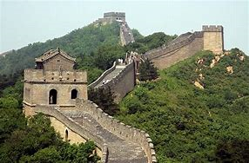
SOME PICTURES
一些图片
GREAT WALL
长城

Slide 33

SOME PICTURES
一些图片
SKY TEMPLE
天空神庙
SKY TEMPLE
天空神庙

Slide 34

SOME PICTURES
一些图片
BEIJING
北京

Slide 35
THANKS FOR WATCHING
GROUP B.
PRESS THE HOME BUTTON WHEN IT APPEARS
TO GO TO THE MENU
感谢观看
GROUP B。
出现主屏幕按钮时按该按钮
转到菜单

